Slide 1
Board Games
Aline Barbiaux – Manon Libert

Slide 2
How board games …
Were invented
Have various types
Are used in education
Turned into a passion
Got computerized

Slide 3
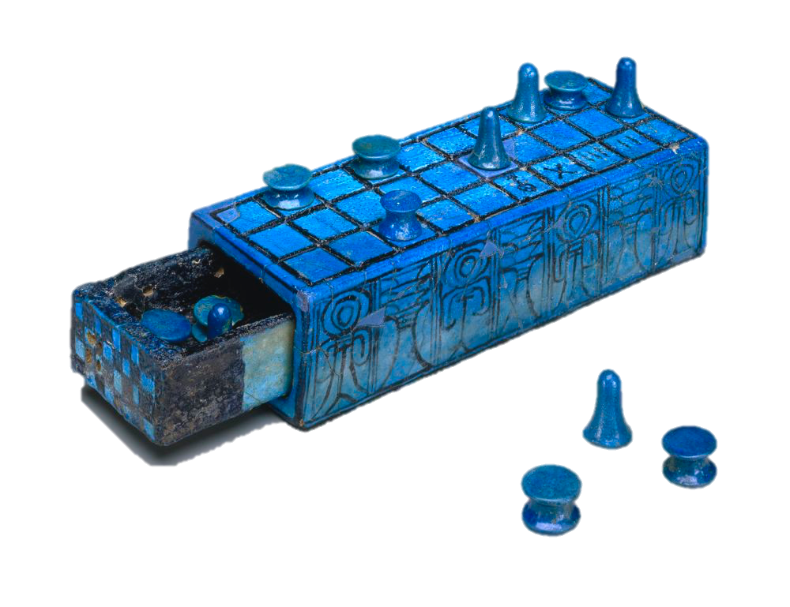
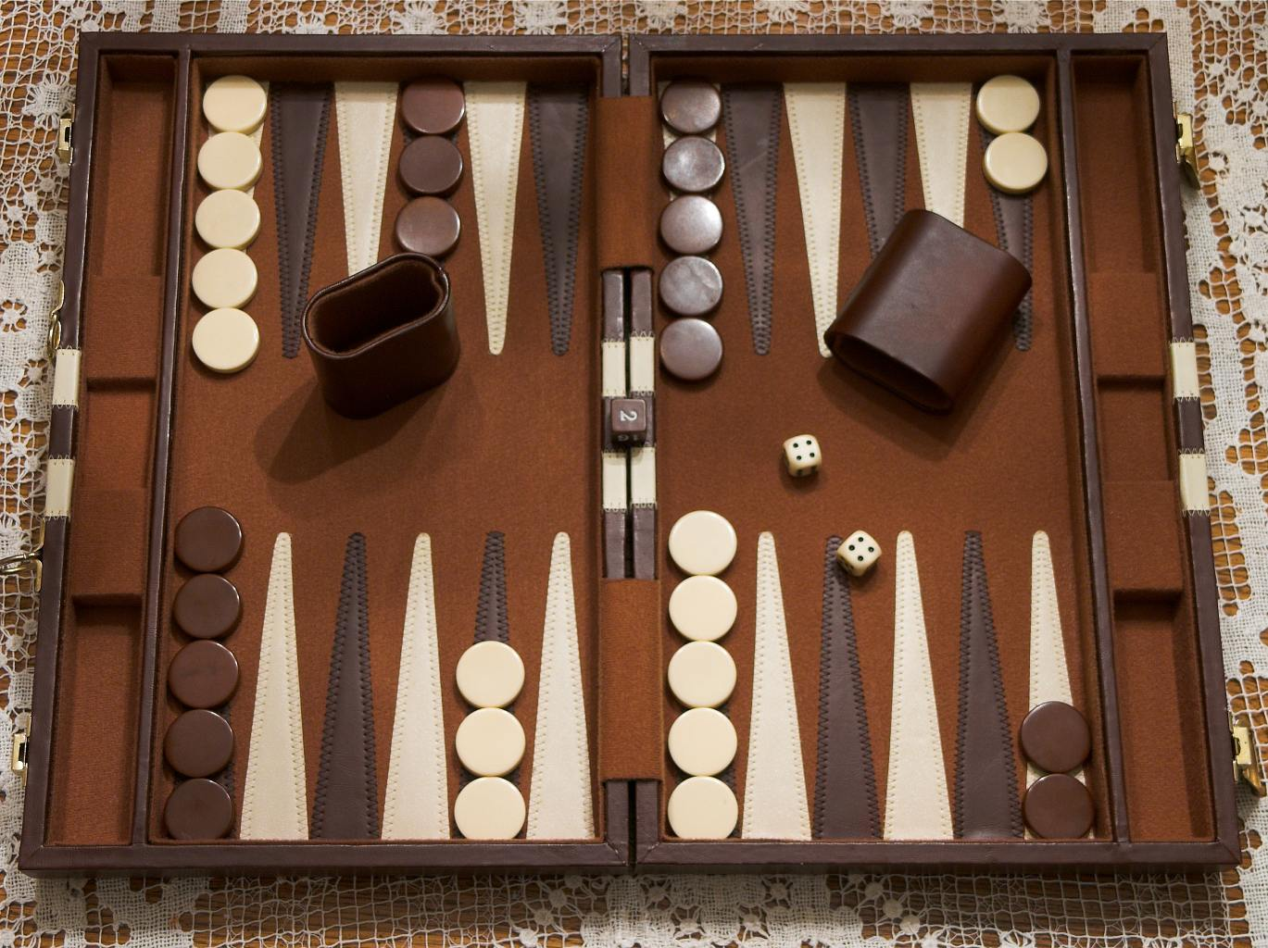
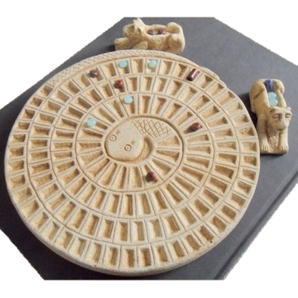
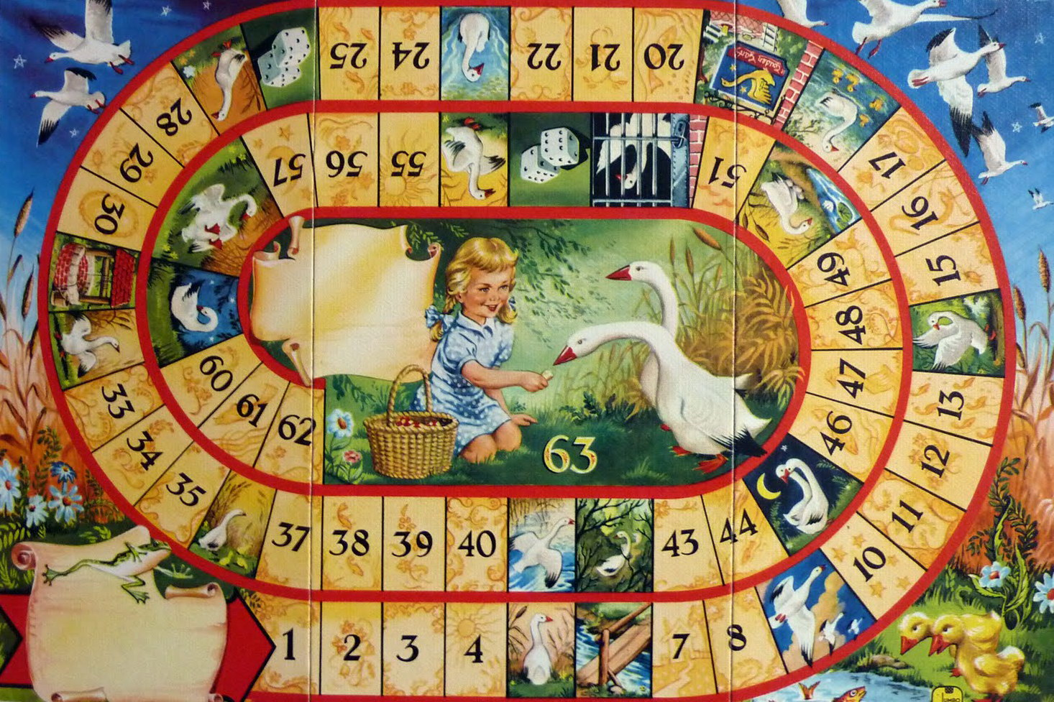
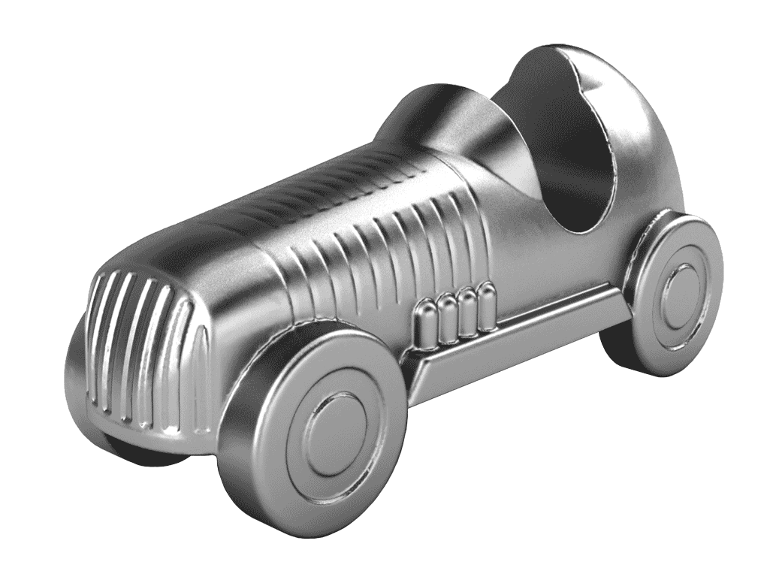
Invention & History - Egypt
“Senet”
Backgammon
“Mehen”
Goose Game

Slide 4
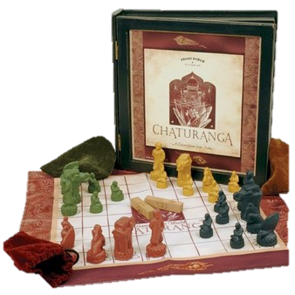
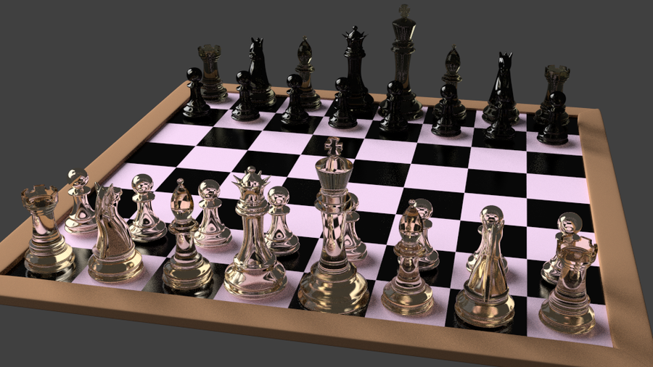
Invention & History- India
“Chaturanga”

Slide 5
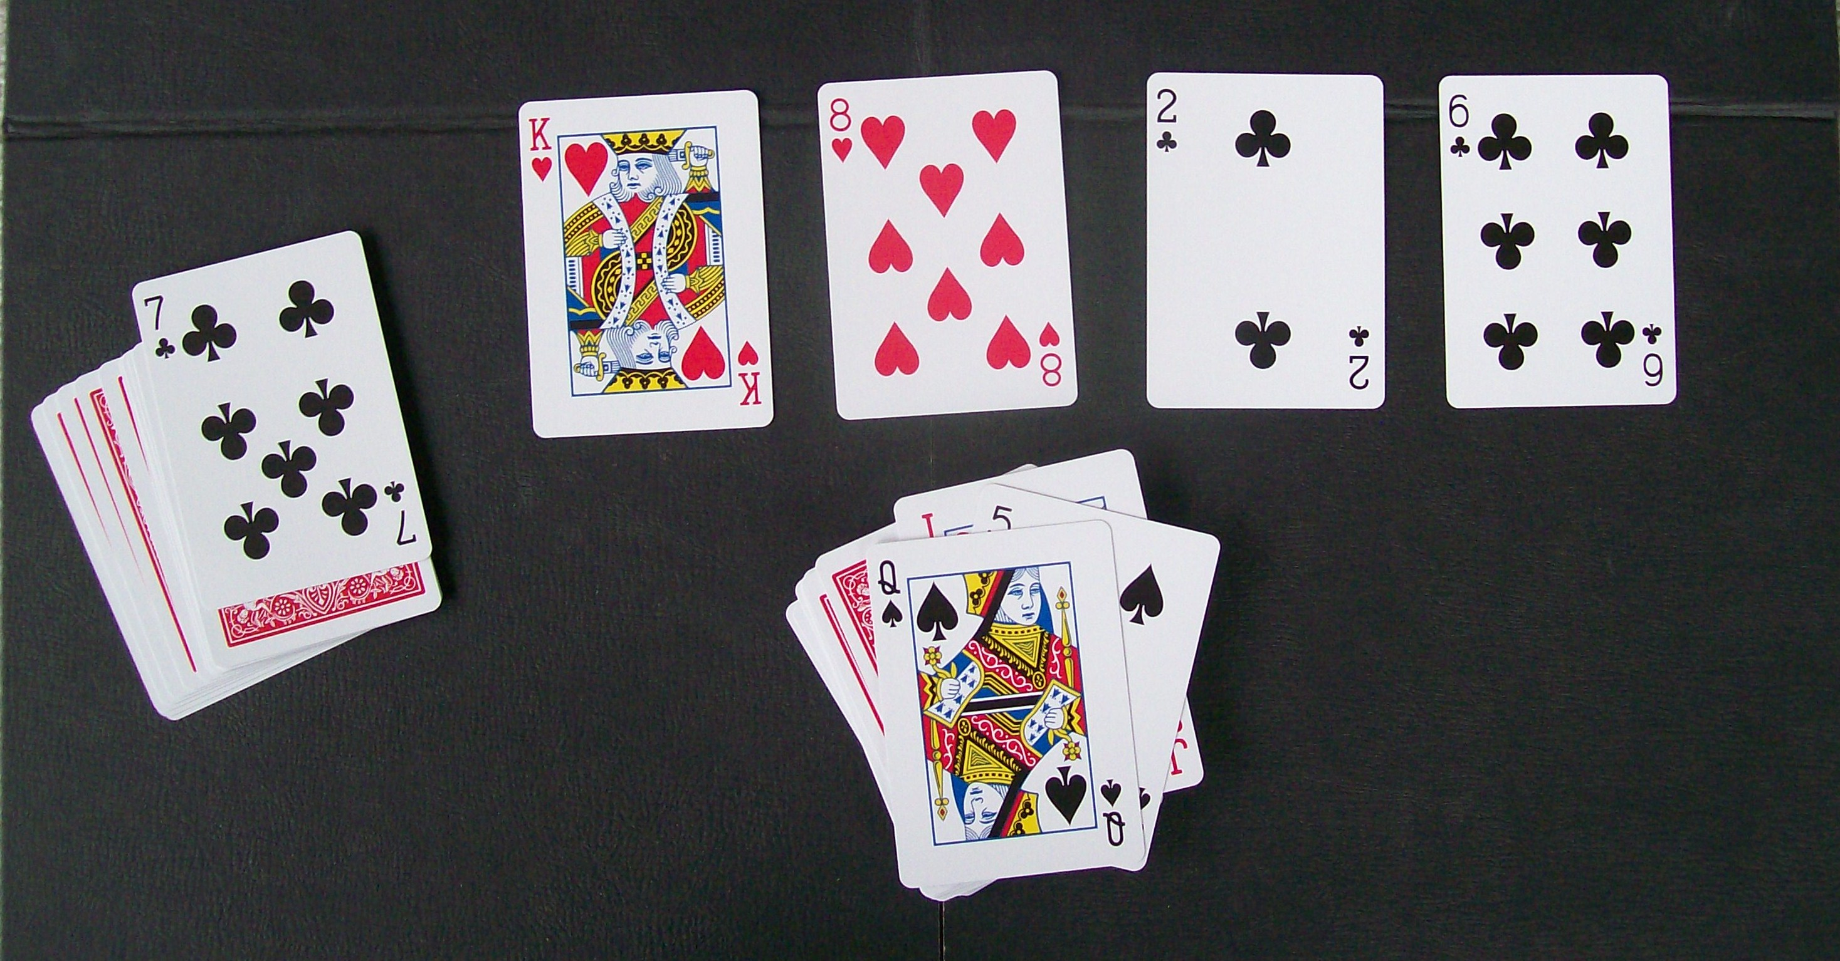
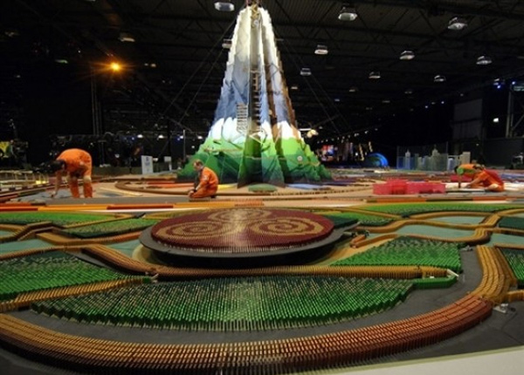
Various types
Cards games & Dominos

Slide 6
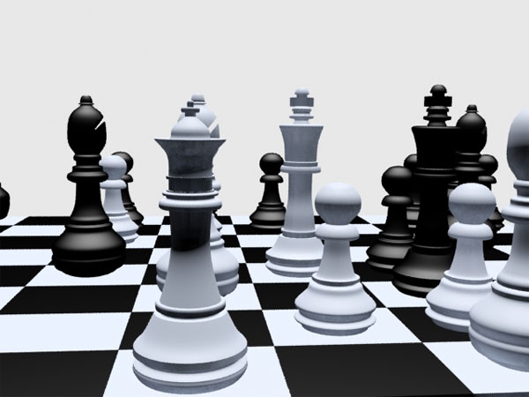
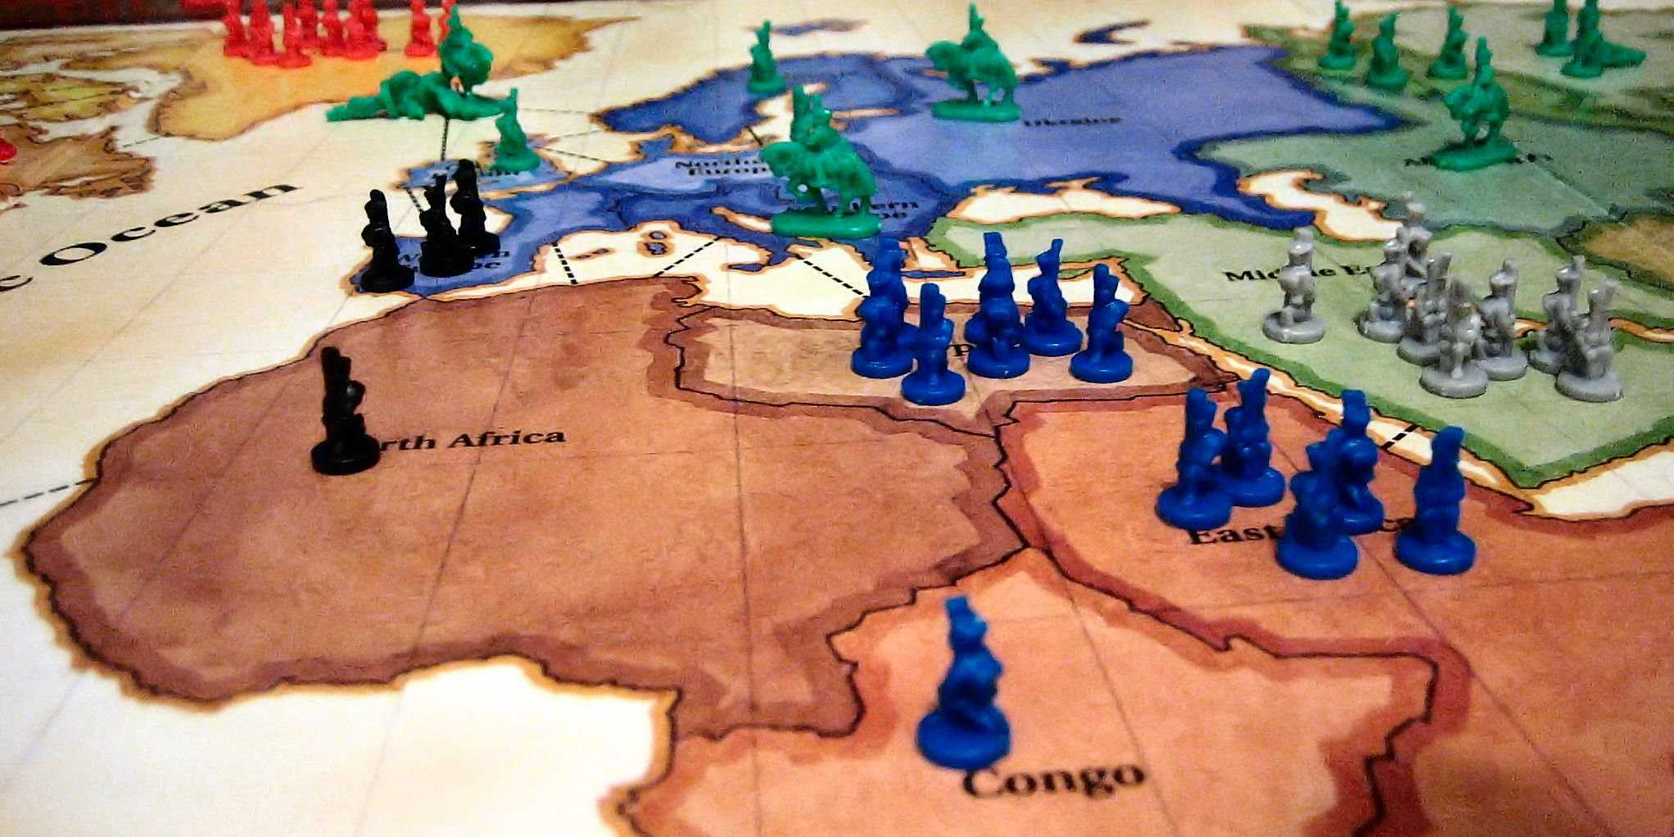
Various types
Strategy with & without luck

Slide 7
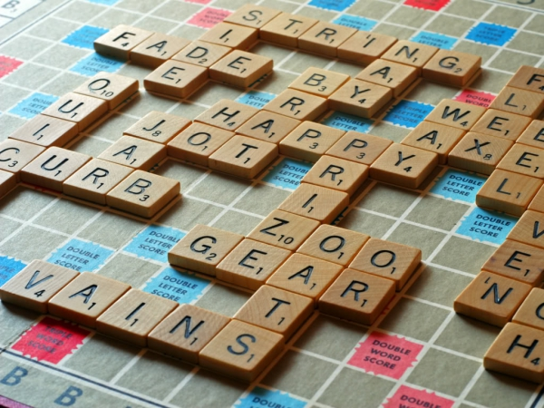
Various types
Spelling, language

Slide 8
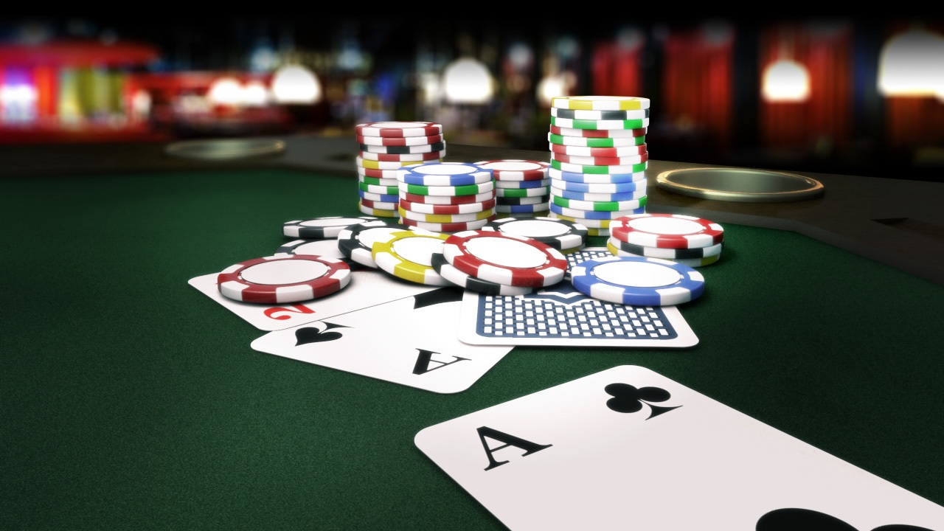
Various types
Gambling

Slide 9
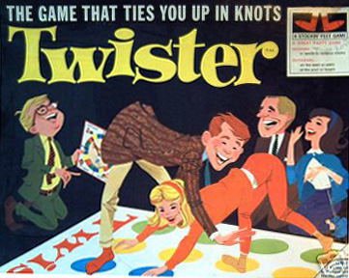
Various types
Skills

Slide 10

Various types
Collective

Slide 11
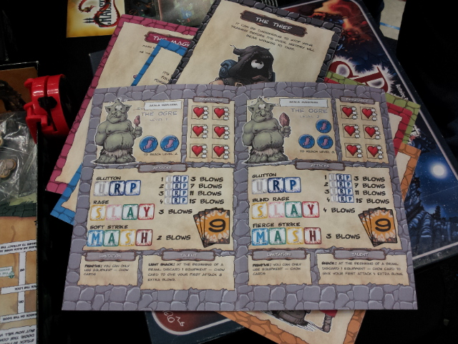
Various types
Cooperative

Slide 12
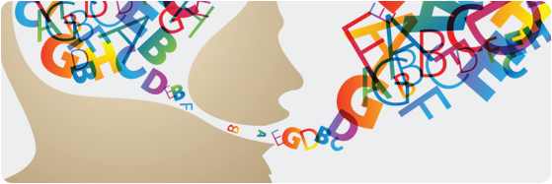
What about education ?
Educating with board Game
Used by speech therapists
Specially for primary pupils
Dyscalculia, Dyslexia
Contentious?

Slide 13
Passionate people
Poker WSOP
Club
board games cafés
Toy Library

Slide 14

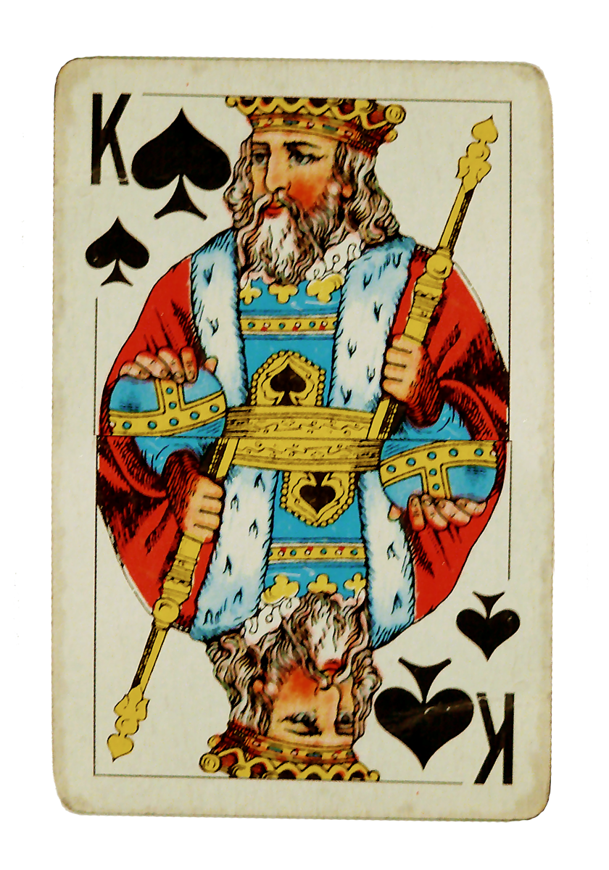
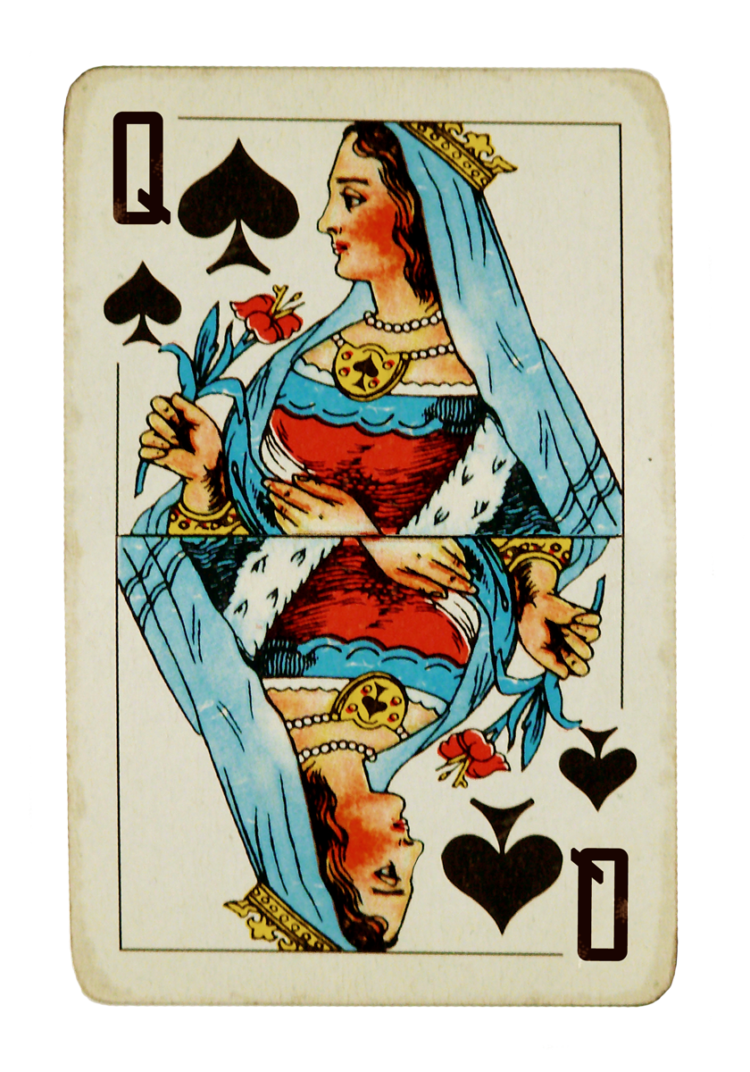
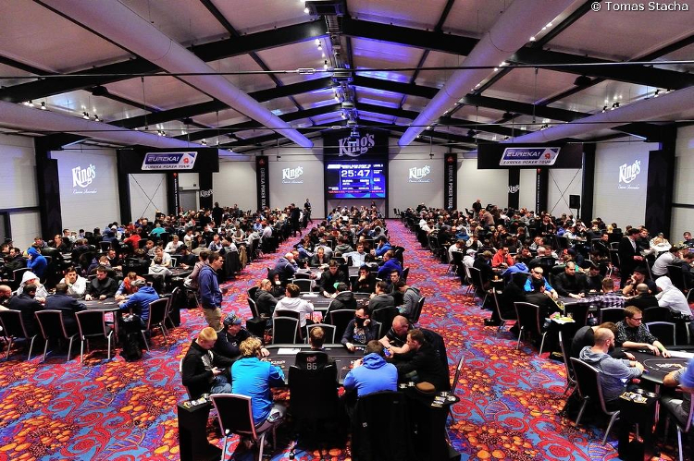



Passionate people - Poker

Slide 15
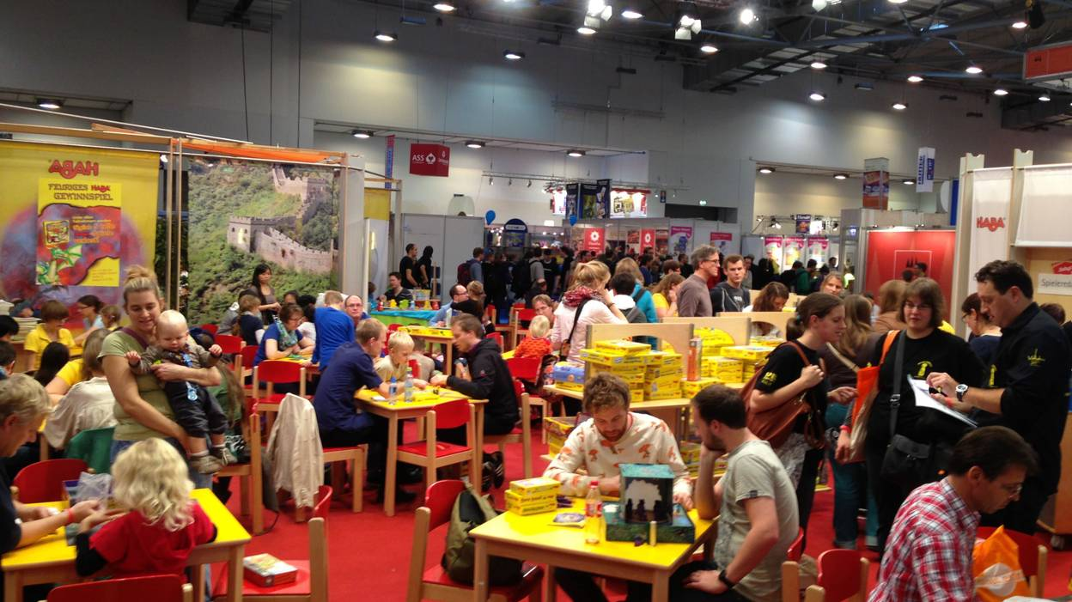
Passionate people - clubs
Often small associations
Outside performance
Essen, worldwide capital of board games

Slide 16
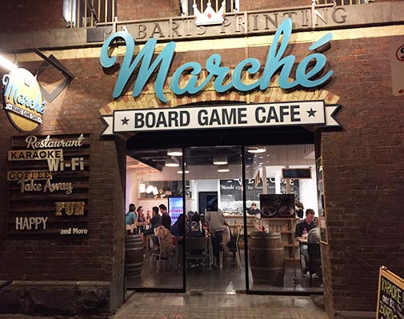
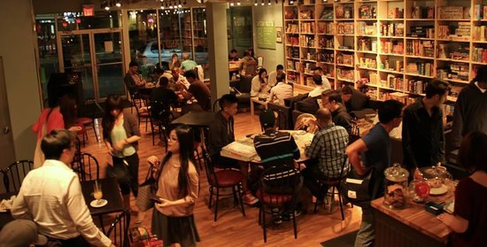
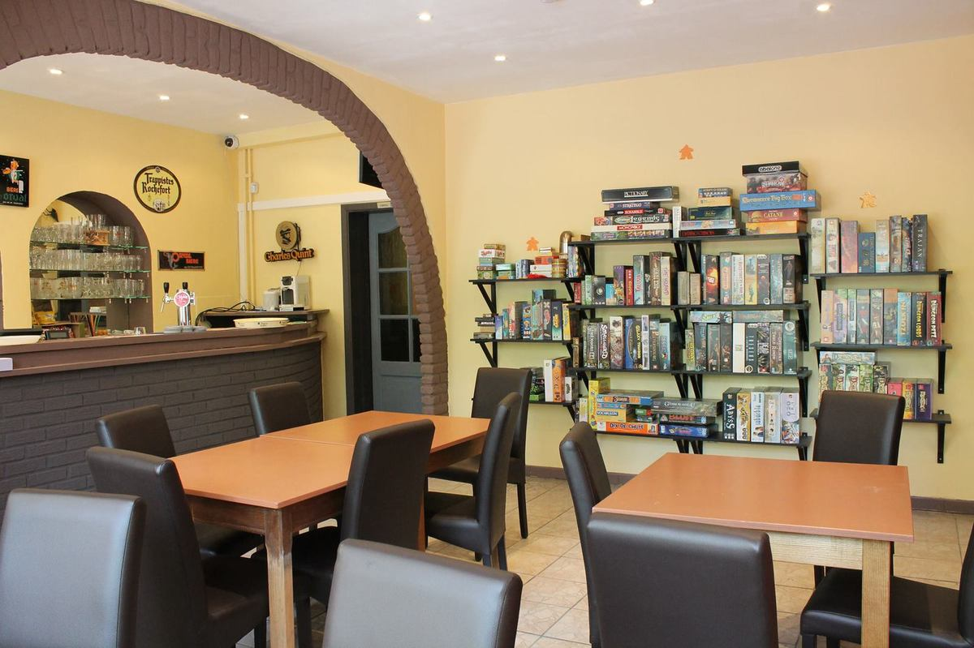
Passionate people Bord Game Café

Slide 17
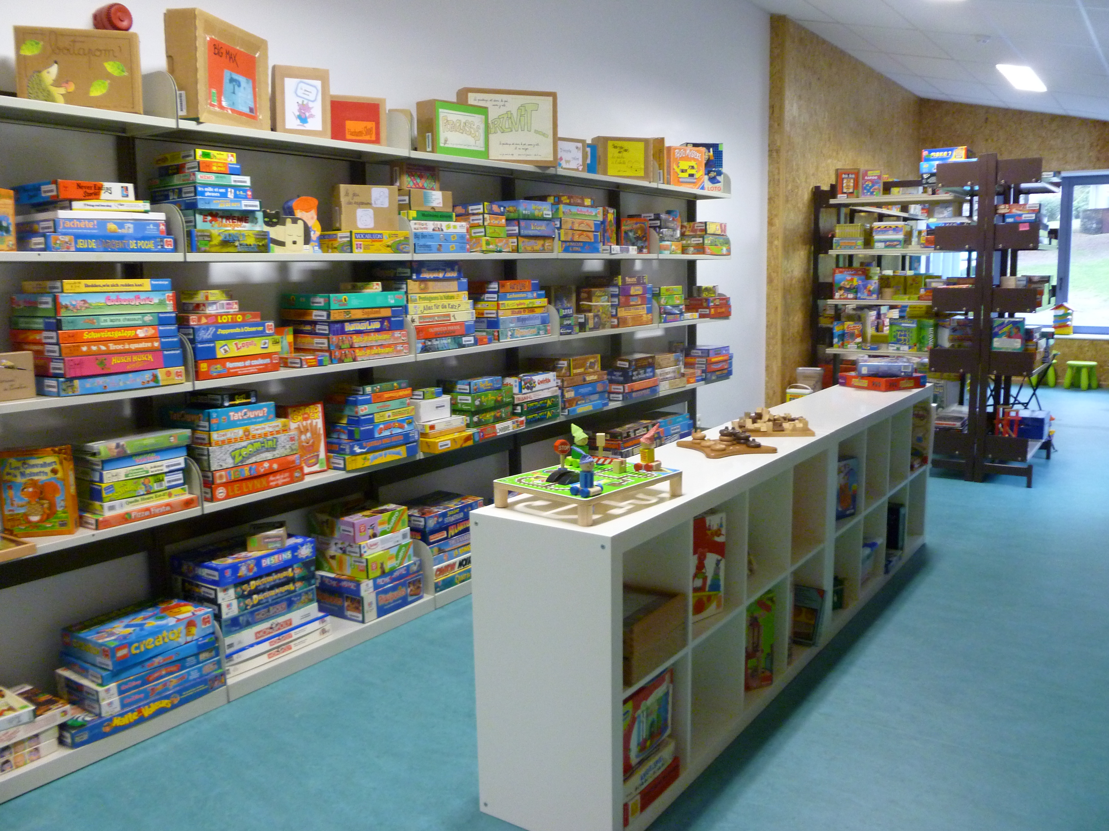
Passionate people – Toy library

Slide 18
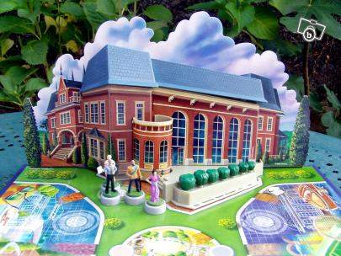
Nerd Alert !
Interactive games

Slide 19
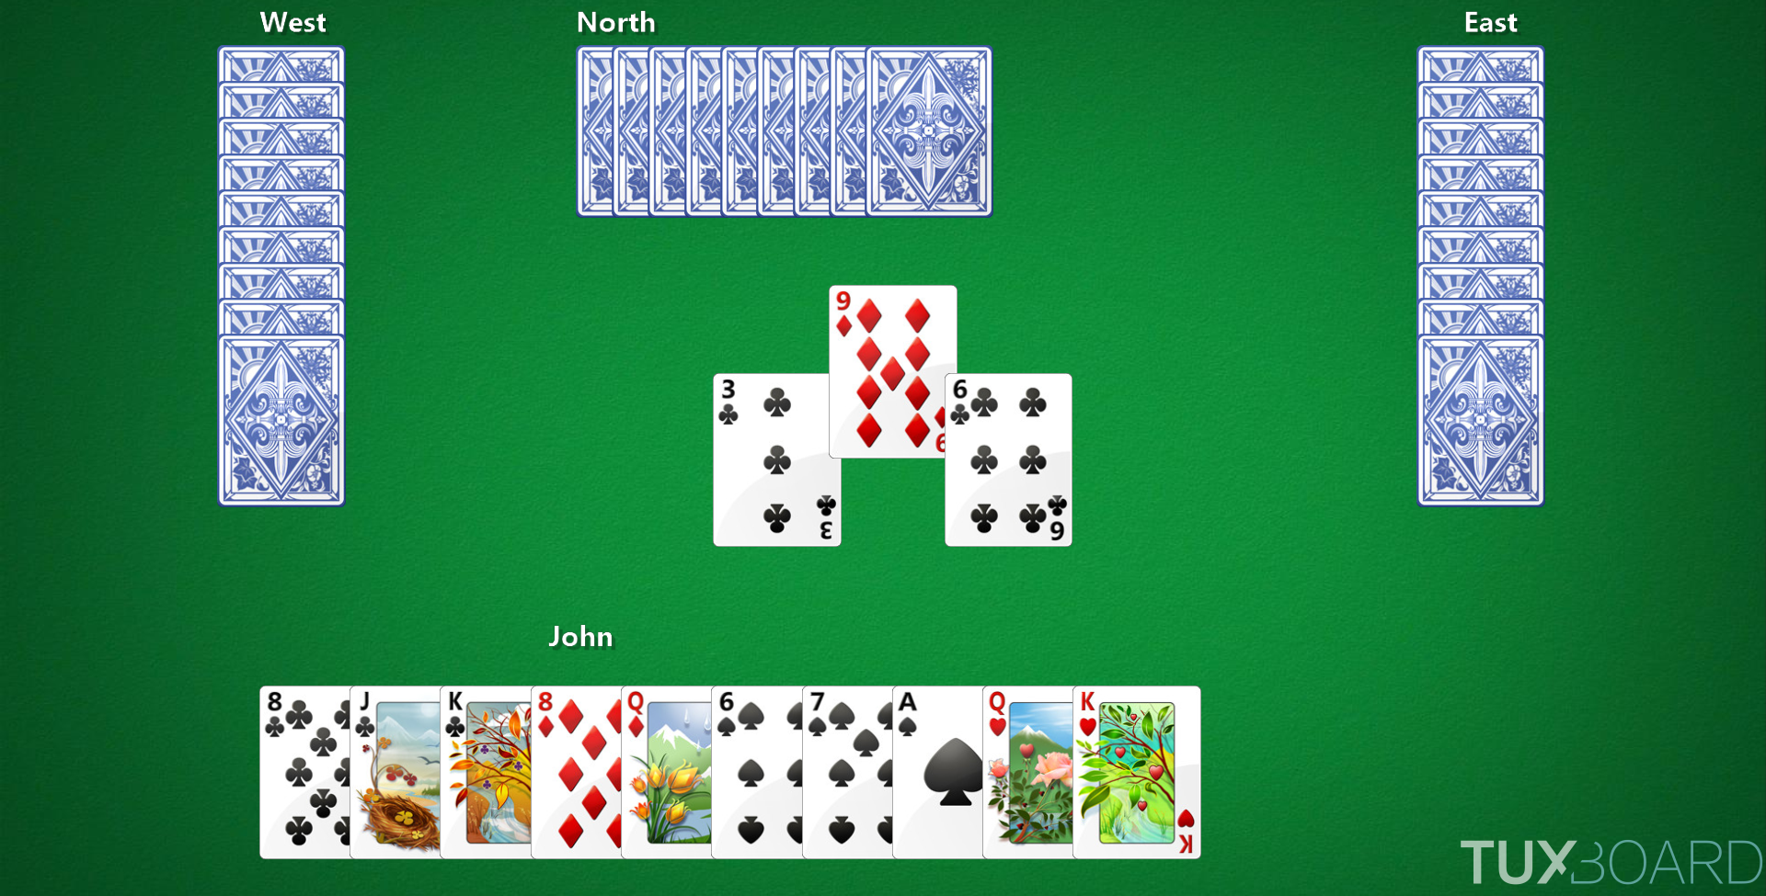
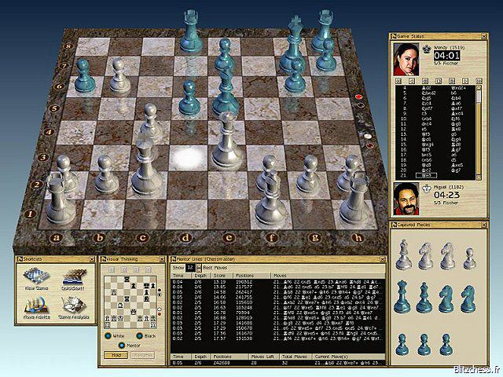
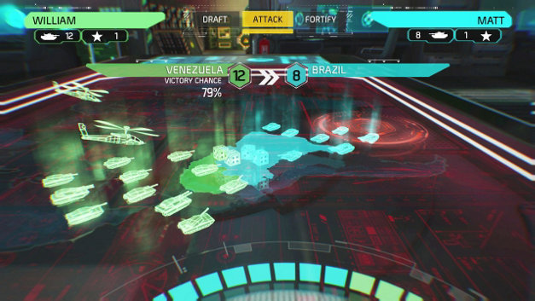
Nerd Alert !
Computerized games

Slide 20
Nerd Alert !
Online tchat and competition
Playing against computer

